Slide 1
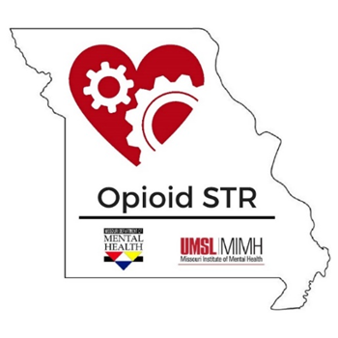
The Missouri State Opioid Response: Modifying the Response for 2019
Fred Rottnek, MD, MAHCM
Missouri University of Science and Technology
October 25, 2019

Slide 2
Today’s Session
Discuss the impact of the opioid epidemic on the US and the Midwest
Describe the Missouri approach to the opioid epidemic
Recognize an opioid overdose and administer naloxone
Questions

Slide 3
What’s different now on the streets?
People are dying at higher rates
Opioids are purer
Opioids are cheaper
Opioids are easier to get
Opioids are deadlier
Fentanyl
Fentanyl-like substances, such as carfentanil

Slide 4
Why are people dying each day?

Slide 5
Notes:
National data

Slide 6
Source: CDC WONDER

Slide 7
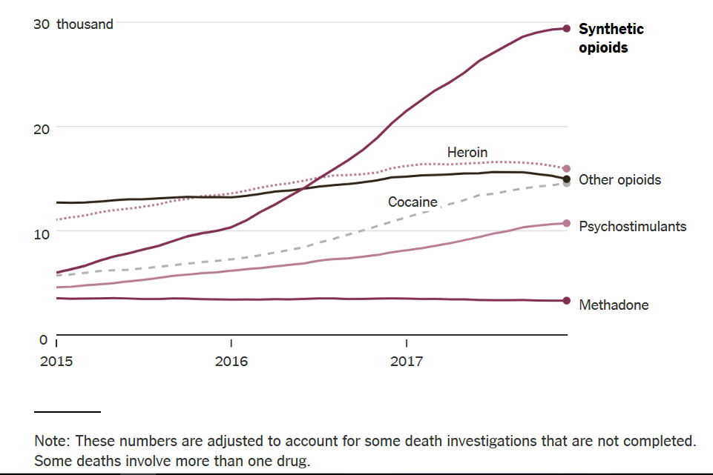
Nationally, Synthetic Opioids Are Driving Up the Overdose Rate
Overdose deaths in thousands in preceding 12 months
A reminder of the steep increase in deaths nationwide, driven by Fentanyl
Source: New York Times
Notes:
https://www.nytimes.com/2018/08/15/upshot/opioids-overdose-deaths-rising-fentanyl.html

Slide 8
Notes:
Only include the slide specific to your region when you present. You can delete the remaining regional slides. Each slide highlights the number of overdose deaths in your region over time (blue bar) as well as a comparison to how your regions OD death rate (orange line) compares to the overall rate in Missouri (black line). You’ll notice that many of the regions have a lower rate than the state however most regions have seen an increase in OD deaths every year since 2003.

Slide 10
What’s being done around the world to address the epidemic
Prevention
Prescription drug monitoring
Mental health parity laws
Prescribing guidelines
Alternative pain treatments
Treatment
Expanded access to medical treatment for OUD
Harm Reduction
Syringe access
Safe consumption sites
Good Samaritan laws
Increased access to overdose education and naloxone
Recovery
Peer support, Community, Domains of health and wellness
Notes:
Model used to build MO STR project
Harm reduction source: http://onlinelibrary.wiley.com/doi/10.1080/09595239800187011/epdf
MAT has been shown in multiple studies to reduce overdose deaths

Slide 11
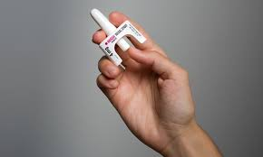
(Missouri Opioid & Heroin Overdose Prevention and Education) DMH + NCADA + MIMH www.mohopeproject.org

Slide 12
State Targeted Response to the Opioid Crisis Grants (Opioid STR)
Missouri: $10,015,898 x 2 years = $20,031,796
Service grant; at least 76% for treatment & recovery support

Slide 13
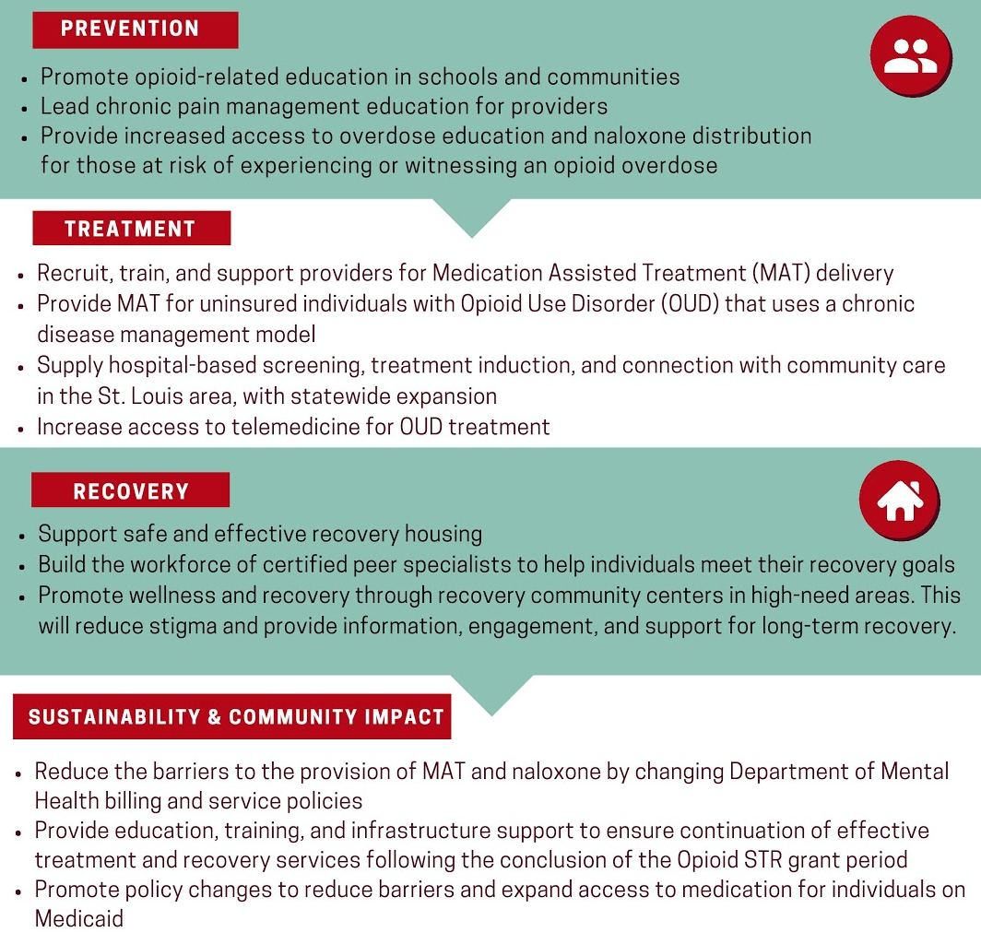
Missouri’s
Plan
“Combined with coordinated collaboration and sophisticated evaluation,
The Opioid STR project aims to transform the system of care for OUD in Missouri.”
Notes:
Here are the 4 buckets of the STR Project

Slide 14
Opioid STR Prevention Efforts
Implement evidence-based primary prevention school programming in two high need areas in the state
Provide professional telehealth education and case consultation on chronic pain management in primary care settings
Expand implementation of Overdose Education and Naloxone Distribution (OEND)

Slide 15
Opioid STR Treatment Efforts
Primary goal: Increase access to medical treatment for uninsured individuals with opioid use disorder (OUD) through interdisciplinary provider training, direct service delivery, healthcare integration, and improved transitions of care.
Agonist and partial-agonist evidence-based medications…
Primarily buprenorphine products (Suboxone)
Too many specific treatment objectives to list…

Slide 16
Why Do People Use Opioids?
Alex Walley, MD
Notes:
The transition from acute to chronic use.
The modulation moves from Normal-Euphoric to Normal-Withdrawal.
The opioid dependent person chases the Normal through continued opioid use. The euphoria is but a memory—but a powerful memory nonetheless.

Slide 17
Alex Walley, MD
Notes:
Maintenance agonist tx brings people out of that… back into the white
This graph represents the opioid-dependent brain and brain chemistry, NOT an opioid naïve brain.

Slide 18
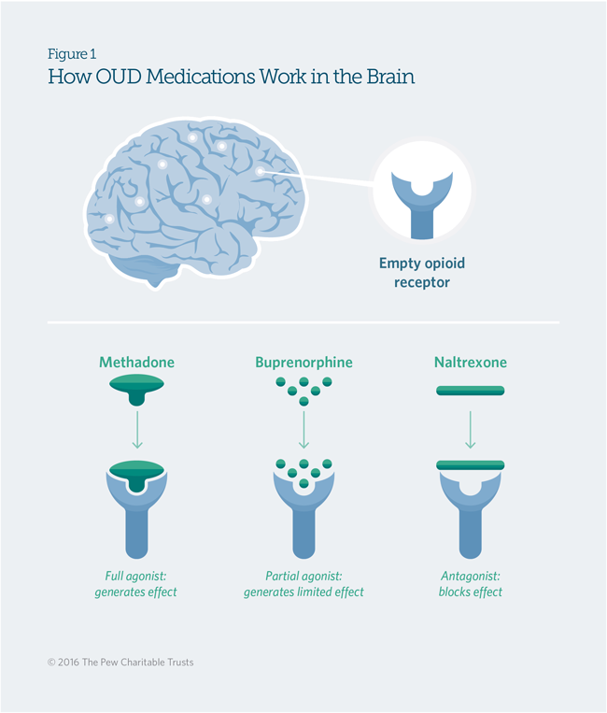
Medication First Model – Why?
Fairly immediate relief from distress caused by withdrawal symptoms
Stabilizes the client
Decreases craving
Creates mental ability for patient to engage and benefit from psychosocial treatments
Increased retention in treatment
Decreased deaths from overdose
Notes:
Same thing – connect people first with the thing they need the most. The sooner we can help people get to a place where they can participate in recovery, the sooner they can be in recovery

Slide 20
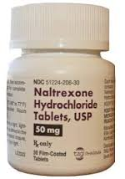
Naltrexone
Full opioid antagonist—it blocks the effects of
Opioid
Alcohol
Oral and depot (Vivitrol) formulations
Best for relapse prevention
However, no significant dopamine increase since naltrexone is a complete antagonist
Notes:
Notes:
Data supports efficacy for relapse prevention in patients in controlled environments (e.g., inpatient programs and corrections facilities) who have been successfully detoxed
Success depends on patient’s adherence to naltrexone regimen—when the patient has a choice
Relapse puts patient at greater risk of opioid overdose due to down-regulation of receptors

Slide 21
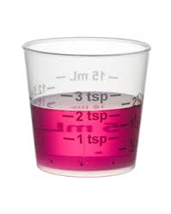
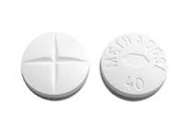
Methadone
Full opioid agonist – a synthetic opioid
Well known to the medical community with data to support effectiveness in community-based OTP settings
Full agonist action increases dopamine and neurotransmitter function
Limited by geography
Notes:
Safe and effective with OTP service wrap-arounds
Great dopamine push
However, it’s availability is limited to those who can access OTP’s
It has overdose potential due to respiratory depression

Slide 22
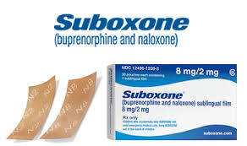
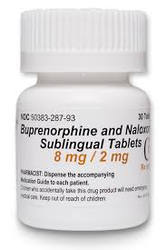
Buprenorphine
Partial opioid agonist—a synthetic opioid
Buprenorphine (Subutex)
Buprenorphine/Naloxone (Suboxone)
New depot formulation (Sublocade)
Partial agonist action increases dopamine and neurotransmitter function
Research shows it works in community-based practices from any medical specialty
Notes:
Formulations with naloxone decrease potential for misuse.
Low overdose potential due to ceiling effect
Plenty of studies indicate efficacy.
Can start while someone’s in withdrawal, don’t need to wait multiple days like Vivitrol

Slide 23
Patient Profiles: Best Fit for Each Agent
Vivitrol: Vivian developed her only addiction following a complicated C-section
Suboxone: Sam started substances as a teen. His dopamine pathways have been altered.
Methadone: Marty failed suboxone treatment after two treatment programs and a post-incarceration trial of Vivitrol
Notes:
Vivitrol:
KP is a 35 y/o woman who developed an addiction to prescription opioids (Vicodin) following incisional complications from a C-section with her third child. (She has no previous SUD history). After an MVA in which she fell asleep at the wheel, she checked into a SUD program at a local hospital. Seven days after admission, she was preparing for discharge and received her first Vivitrol injection.
She is an RN at a local hospital, and she plans to return to work in one more week after she returns home.
She is married, a mother of three, and has a promising career as a Clinical Nurse Leader.
Why is she a good candidate for Vivitrol?
Induction occurred in a controlled environment.
She has no previous addiction history.
She is highly motivated.
She is well-resourced.
Methadone:
MH is a 28 year-old who presents for methadone maintenance after 2 unsuccessful trials with naltrexone (Vivitrol, each just prior to release from two 3 month stays the Saint Louis County Jail). He then tried suboxone therapy through a community-based mental health center; however, his cravings were not decreased at 24 mg/day. After restarting IV heroin for the third time, he reported back to his community mental health center and was referred for a trial of methadone maintenance.
He lives in North Saint Louis County and can access an OTP by Metro.
He finds his cravings are controlled on 60 mg methadone/day.
Patient failed other treatments; lack of control of cravings
Resources: Opioid Morphine Equivalent Conversion Factors, https://www.cms.gov/Medicare/Prescription-Drug-Coverage/PrescriptionDrugCovContra/Downloads/Opioid-Morphine-EQ-Conversion-Factors-March-2015.pdf
Suboxone: Long SU history; brain chemistry affected early and often by substances; needs dopamine reinforcement
Resources: https://www.samhsa.gov/medication-assisted-treatment/treatment/buprenorphine

Slide 24
Opioid STR Recovery Support Efforts
Provide recovery housing for 500 individuals (per year)
Use Peer Support Specialists with personal substance use experience
Activate four recovery community centers in high-need areas of the state
Provide recovery management checkups to keep individuals engaged in treatment

Slide 25
Percent Increase in Opioid Overdose Deaths Comparison
2015-2016
28%
35%
110%
2016-2017
16%
5%
-10%
Missouri went from being well-above the national average in number
of deaths to well-below. This improvement is largely due to the drastic
decrease in overdose deaths in St. Louis City.

Slide 26
MO-HOPE began
STR began
Source: St. Louis City and St. Louis County Medical Examiners

Slide 27
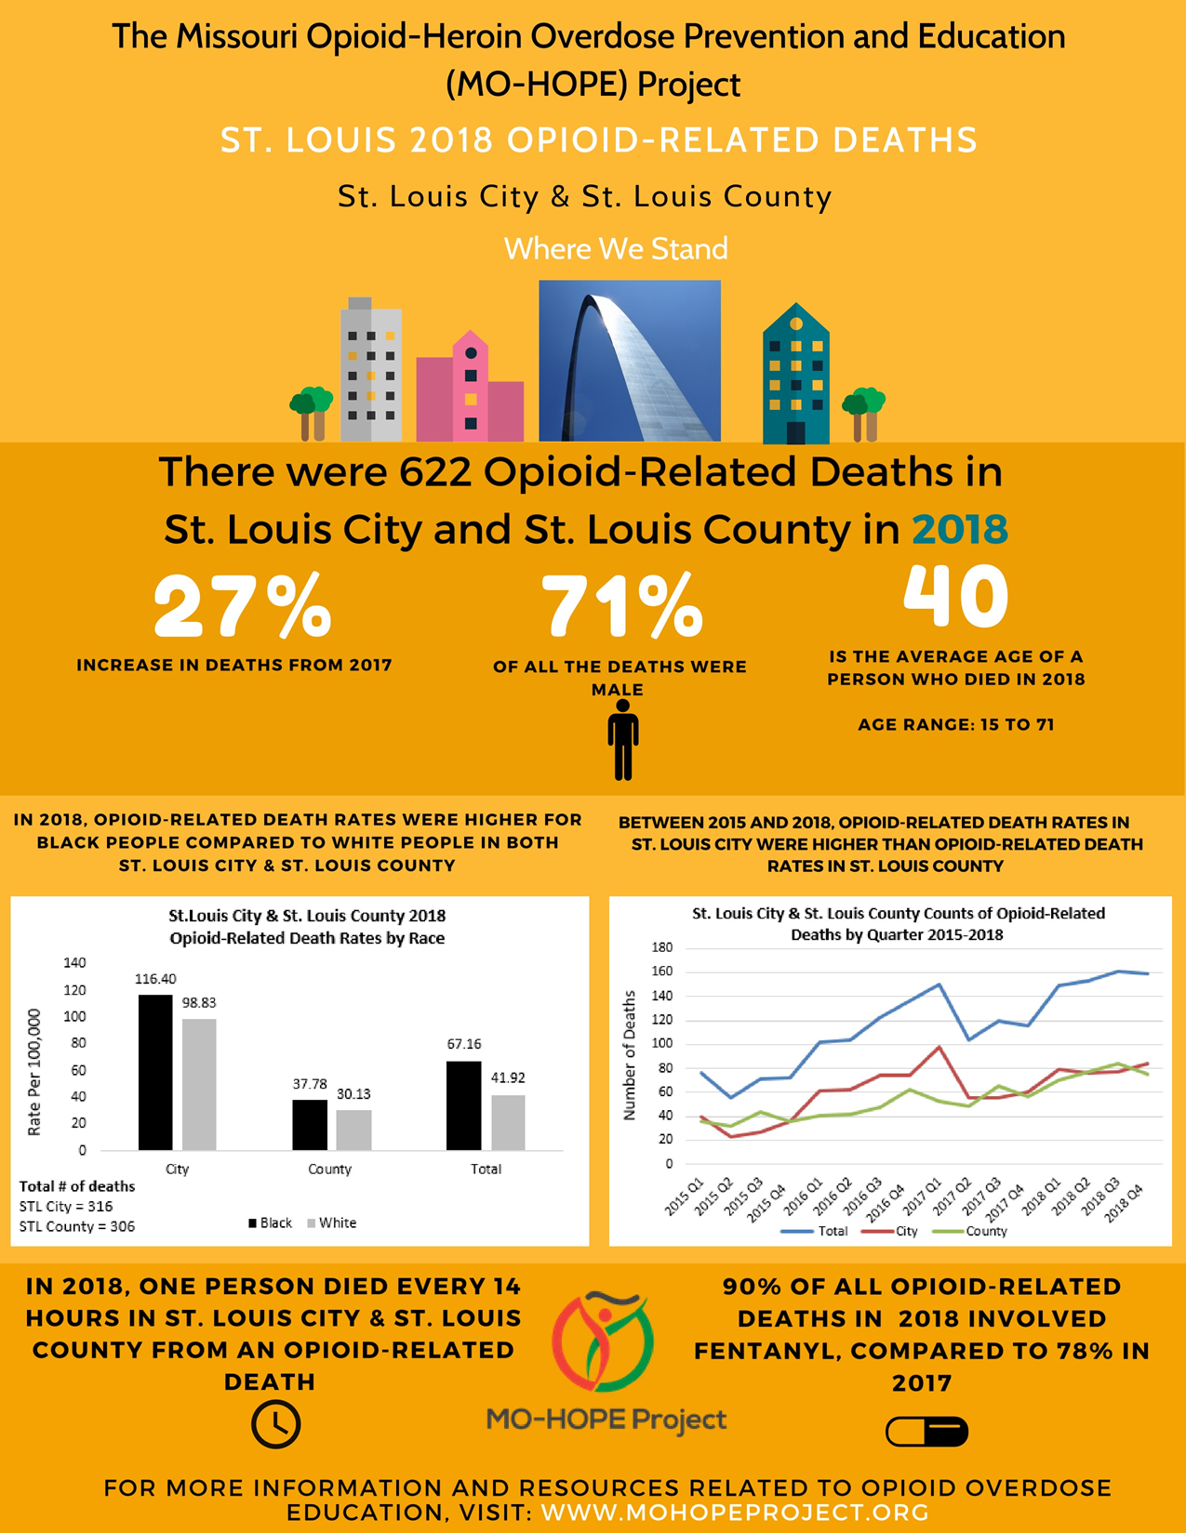

Slide 28
Sustainability and Community Impact
Primary goal: Increase the likelihood of sustainability through policy and practice change
MO HealthNet policy changes…
Research and evaluation of effectiveness…
Gain momentum to change reimbursement structures…
*Catalyze a culture and practice shift in the way we address opioid use…

Slide 29
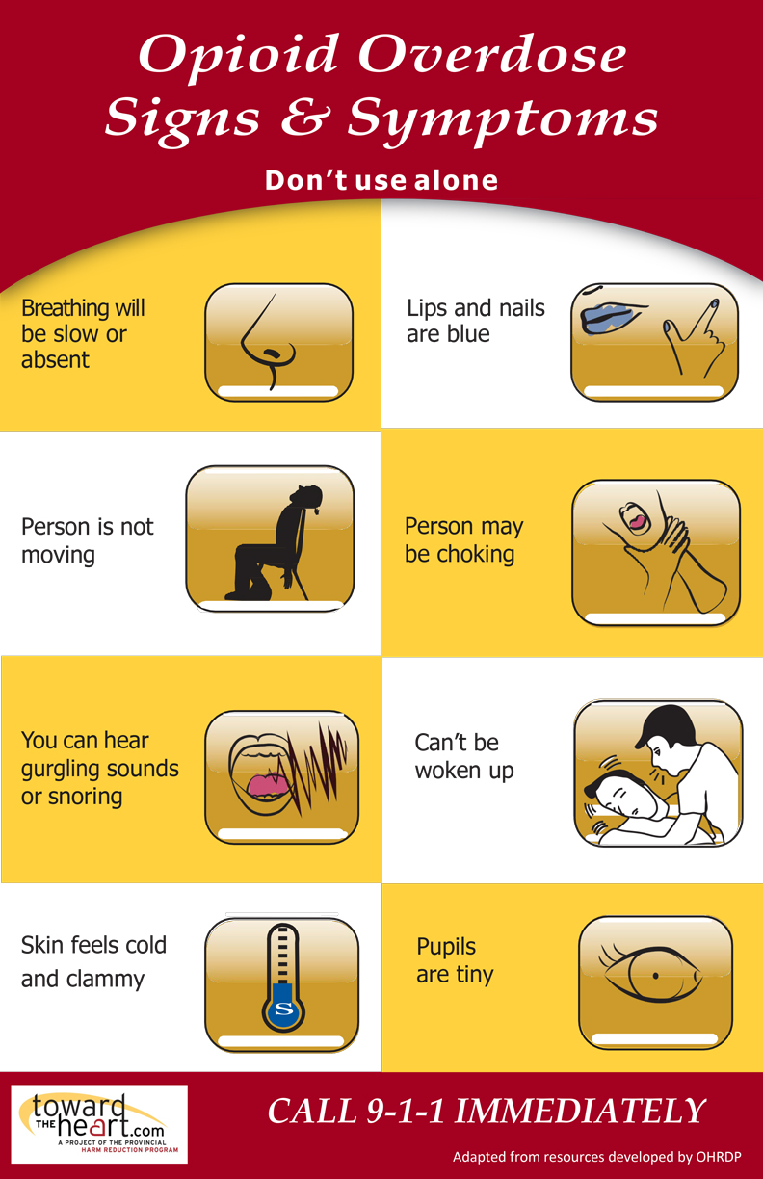
Notes:
Any single sign or symptom by itself may not mean a whole lot. But, when you put them together: altered consciousness, altered breathing, pinpoint pupils, that equals HEROIN overdose (or some other opioid)… There’s a huge range in time between use and OD – sometimes it’s a minute, sometimes over 6 hours… if you come upon someone who OD’s you never know how long it’s been, always give naloxone… the image of an OD being someone with a needle in their arm is inaccurate, more often than not

Slide 30
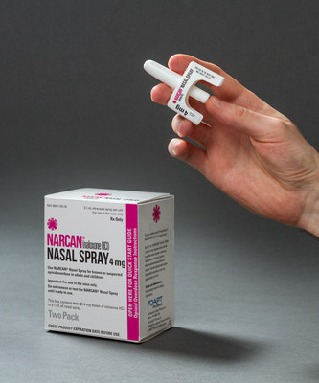
While waiting for EMS to arrive…
At least try to get breathing restarted by giving the antidote via nasal spray
Administer rescue breathing
(if pulse)
Administer chest compressions
(if no pulse)
Notes:
Rescue breathing – 1 breath every 7 seconds – if the brain is getting any oxygen at all then naloxone should work – even if you can get in just a little bit with your breaths that could mean life instead of death

Slide 31
While waiting for EMS to arrive…
Naloxone (Narcan®): a drug that reverses opioid overdose effects
ADAPT Pharma antidote delivery system
NO assembly required
NO separate syringe
NO separate delivery device

Slide 32
Deploying the nasal spray kit

Slide 33
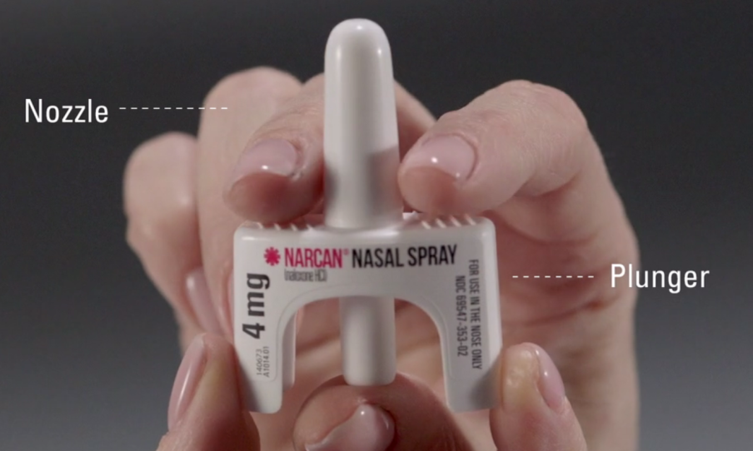
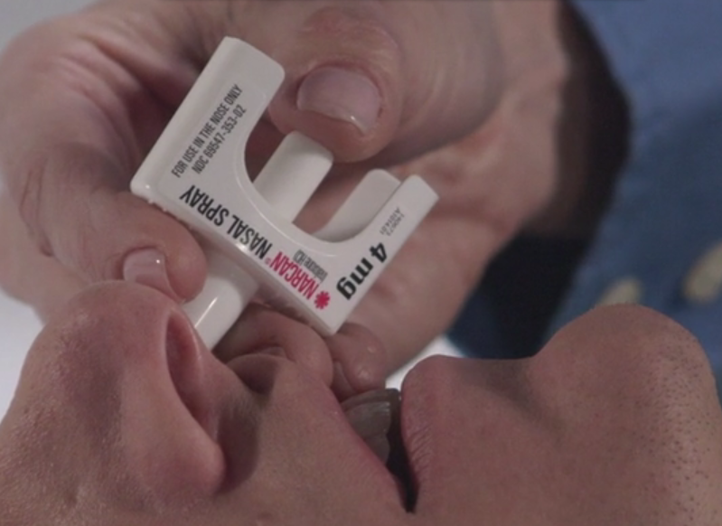
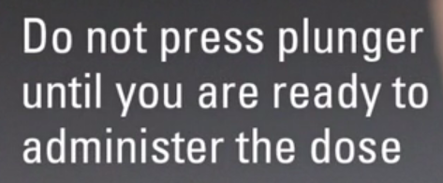
Deploying the nasal spray kit

Slide 34
Resources and Contacts (National)
Association of Medical Education and Research in Substance Abuse (AMERSA), https://amersa.org/
National Institute for Drug Abuse (NIDA), https://www.drugabuse.gov/
American Society of Addiction Medicine (ASAM), https://www.asam.org/
SAMHSA Treatment Locator, https://findtreatment.samhsa.gov/

Slide 35
Resources and Contacts (Regional)
MOHope Project, https://mohopeproject.org/
Missouri’s Opioid State Targeted Response, https://missouriopioidstr.org/ Philip.horn@mimh.edu
Assisted Recovery Centers of America, ARCA, http://www.arcamidwest.com/ sunealmenzies@arcamidwest.com

Slide 36
Resources and Contacts (Saint Louis University)
Saint Louis University, Family and Community Medicine, https://www.slu.edu/medicine/family-medicine/ Fred.Rottnek@health.slu.edu
SLU Addiction Medicine Fellowship, https://www.slu.edu/medicine/family-medicine/addiction-medicine.php
SLU Center for Substance Use Disorders and Pain Management,
https://www.slu.edu/medicine/family-medicine/center-for-substance-use.php
https://www.slu.edu/medicine/grand-rounds/index.php

Slide 37
The Missouri State Opioid Response: Modifying the Response for 2019
Questions? Comments?
Fred.Rottnek@health.slu.edu

